Slide 1
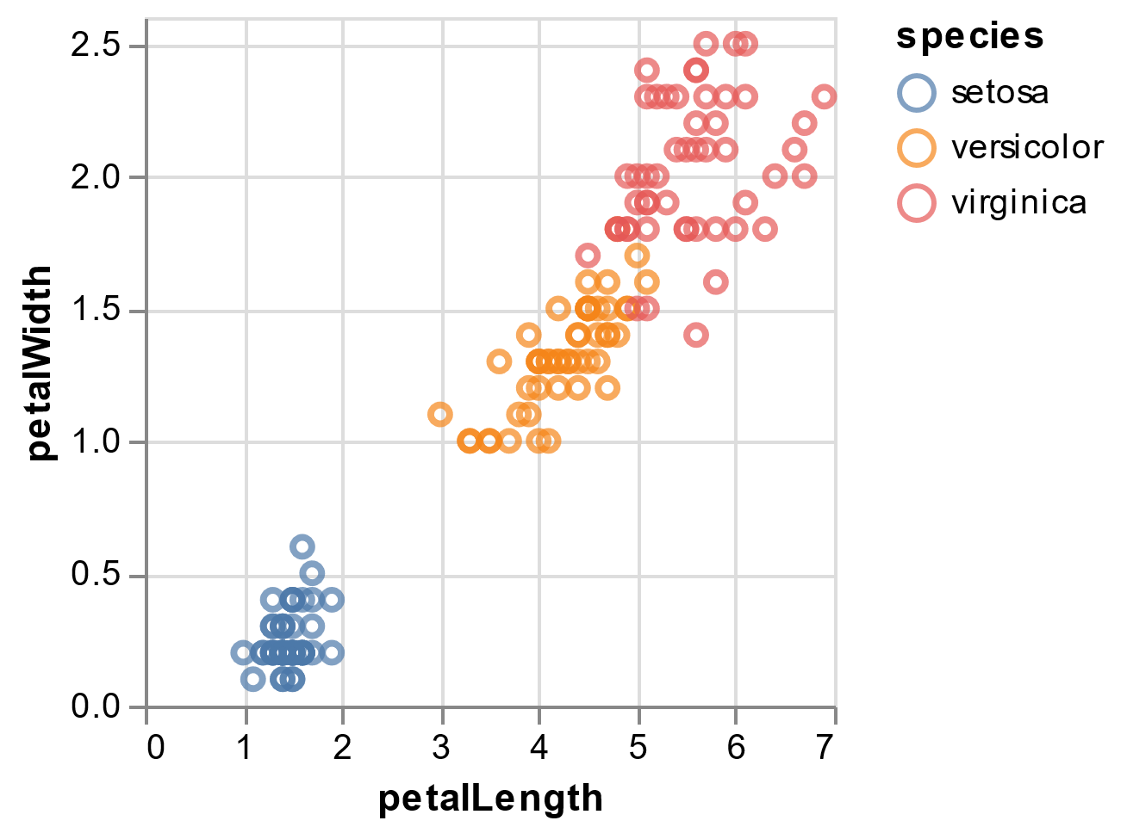
My Awesome Analysis

